Slide 1
Exception Handling
By Gitanjali More

Slide 2
What is Exception in Java? In Java, an exception is an event that occurs during the execution of a program that disrupts the normal flow of instructions. These exceptions can occur for various reasons, such as invalid user input, file not found, or division by zero. When an exception occurs, it is typically represented by an object of a subclass of the java.lang.Exception class.

Slide 3
What is Exception Handling? Exception Handling is a mechanism to handle runtime errors such as ClassNotFoundException, IOException, SQLException, RemoteException, etc. Types of Java Exceptions In Java, exceptions are categorized into two main types: checked exceptions and unchecked exceptions. Additionally, there is a third category known as errors. 1 Checked Exception 2 Unchecked Exception 3 Error

Slide 4
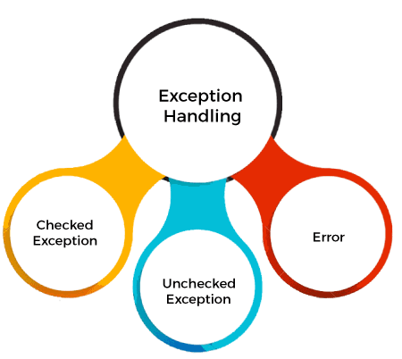

Slide 5
1. Checked Exceptions Checked exceptions are the exceptions that are checked at compile-time. This means that the compiler verifies that the code handles these exceptions either by catching them or declaring them in the method signature using the throws keyword. Examples of checked exceptions include: IOException: An exception is thrown when an input/output operation fails, such as when reading from or writing to a file. SQLException: It is thrown when an error occurs while accessing a database. ParseException: Indicates a problem while parsing a string into another data type, such as parsing a date. ClassNotFoundException: It is thrown when an application tries to load a class through its string name using methods like Class.forName(), but the class with the specified name cannot be found in the classpath.

Slide 6
2. Unchecked Exceptions (Runtime Exceptions) Unchecked exceptions, also known as runtime exceptions, are not checked at compile-time. These exceptions usually occur due to programming errors, such as logic errors or incorrect assumptions in the code. They do not need to be declared in the method signature using the throws keyword, making it optional to handle them. Examples of unchecked exceptions include: NullPointerException: It is thrown when trying to access or call a method on an object reference that is null. ArrayIndexOutOfBoundsException: It occurs when we try to access an array element with an invalid index. ArithmeticException: It is thrown when an arithmetic operation fails, such as division by zero. IllegalArgumentException: It indicates that a method has been passed an illegal or inappropriate argument.

Slide 7
3. Errors Errors represent exceptional conditions that are not expected to be caught under normal circumstances. They are typically caused by issues outside the control of the application, such as system failures or resource exhaustion. Errors are not meant to be caught or handled by application code. Examples of errors include: OutOfMemoryError: It occurs when the Java Virtual Machine (JVM) cannot allocate enough memory for the application. StackOverflowError: It is thrown when the stack memory is exhausted due to excessive recursion. NoClassDefFoundError: It indicates that the JVM cannot find the definition of a class that was available at compile-time.

Slide 8
Java Exception Keywords Java provides five keywords that are used to handle the exception. The following table describes each.
Keyword | Description
try | The "try" keyword is used to specify a block where we should place an exception code. It means we can't use try block alone. The try block must be followed by either catch or finally.
catch | The "catch" block is used to handle the exception. It must be preceded by try block which means we can't use catch block alone. It can be followed by finally block later.
finally | The "finally" block is used to execute the necessary code of the program. It is executed whether an exception is handled or not.
throw | The "throw" keyword is used to throw an exception.
throws | The "throws" keyword is used to declare exceptions. It specifies that there may occur an exception in the method. It doesn't throw an exception. It is always used with method signature.

Slide 9
THANK YOU

